Slide 1
Chapter 19: Introduction to Assurance
Overview
Why assurance?
Trust and assurance
Life cycle and assurance
Building security in vs. adding security later

Slide 2
Overview
Trust
Problems from lack of assurance
Types of assurance
Life cycle and assurance
Waterfall life cycle model
Other life cycle models
Adding security afterwards

Slide 3
Trust
Trustworthy entity has sufficient credible evidence leading one to believe that the system will meet a set of requirements
Trust is a measure of trustworthiness relying on the evidence
Assurance is confidence that an entity meets its security requirements based on evidence provided by applying assurance techniques

Slide 4
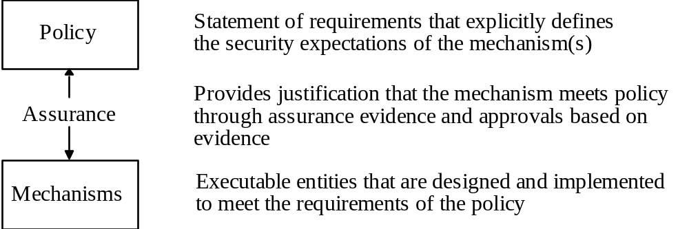
Relationships

Slide 5
Problem Sources
Requirements definitions, omissions, and mistakes
System design flaws
Hardware implementation flaws, such as wiring and chip flaws
Software implementation errors, program bugs, and compiler bugs
System use and operation errors and inadvertent mistakes
Willful system misuse
Hardware, communication, or other equipment malfunction
Environmental problems, natural causes, and acts of God
Evolution, maintenance, faulty upgrades, and decommissions

Slide 6
Examples
Challenger explosion
  Sensors removed from booster rockets to meet accelerated launch schedule
Deaths from faulty radiation therapy system
  Hardware safety interlock removed
  Flaws in software design
Bell V22 Osprey crashes
  Failure to correct for malfunctioning components; two faulty ones could outvote a third
Intel 486 chip
  Bug in trigonometric functions

Slide 7
Role of Requirements
Requirements are statements of goals that must be met
  Vary from high-level, generic issues to low-level, concrete issues
Security objectives are high-level security issues
Security requirements are specific, concrete issues

Slide 8
Types of Assurance
Policy assurance is evidence establishing security requirements in policy is complete, consistent, technically sound
Design assurance is evidence establishing design sufficient to meet requirements of security policy
Implementation assurance is evidence establishing implementation consistent with security requirements of security policy

Slide 9
Types of Assurance
Operational assurance is evidence establishing system sustains the security policy requirements during installation, configuration, and day-to-day operation
  Also called administrative assurance

Slide 10
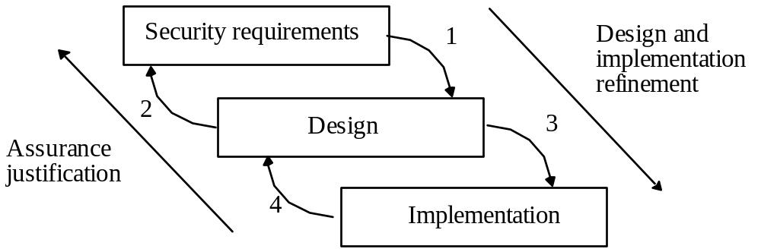
Life Cycle

Slide 11
Life Cycle
Conception
Manufacture
Deployment
Fielded Product Life

Slide 12
Conception
Idea
  Decisions to pursue it
Proof of concept
  See if idea has merit
High-level requirements analysis
  What does “secure” mean for this concept?
  Is it possible for this concept to meet this meaning of security?
  Is the organization willing to support the additional resources required to make this concept meet this meaning of security?

Slide 13
Manufacture
Develop detailed plans for each group involved
  May depend on use; internal product requires no sales
Implement the plans to create entity
  Includes decisions whether to proceed, for example due to market needs

Slide 14
Deployment
Delivery
  Assure that correct masters are delivered to production and protected
  Distribute to customers, sales organizations
Installation and configuration
  Ensure product works appropriately for specific environment into which it is installed
  Service people know security procedures

Slide 15
Fielded Product Life
Routine maintenance, patching
  Responsibility of engineering in small organizations
  Responsibility may be in different group than one that manufactures product
Customer service, support organizations
Retirement or decommission of product

Slide 16
Waterfall Life Cycle Model
Requirements definition and analysis
  Functional and non-functional
  General (for customer), specifications
System and software design
Implementation and unit testing
Integration and system testing
Operation and maintenance

Slide 17
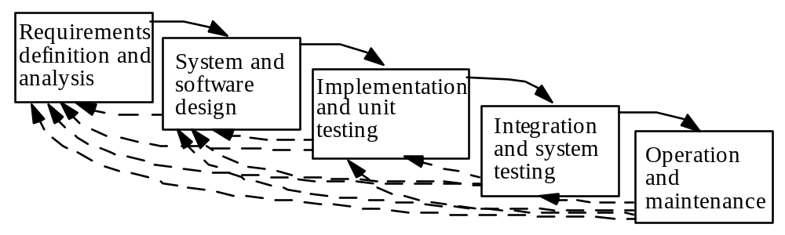
Relationship of Stages

Slide 18
Models
Exploratory programming
  Develop working system quickly
  Used when detailed requirements specification cannot be formulated in advance, and adequacy is goal
  No requirements or design specification, so low assurance
Prototyping
  Objective is to establish system requirements
  Future iterations (after first) allow assurance techniques

Slide 19
Models
Formal transformation
  Create formal specification
  Translate it into program using correctness-preserving transformations
  Very conducive to assurance methods
System assembly from reusable components
  Depends on whether components are trusted
  Must assure connections, composition as well
  Very complex, difficult to assure

Slide 20
Models
Extreme programming
  Rapid prototyping and “best practices”
  Project driven by business decisions
  Requirements open until project complete
  Programmers work in teams
  Components tested, integrated several times a day
  Objective is to get system into production as quickly as possible, then enhance it
  Evidence adduced after development needed for assurance

Slide 21
Security: Built In or Add On?
Think of security as you do performance
  You don’t build a system, then add in performance later
    Can “tweak” system to improve performance a little
    Much more effective to change fundamental algorithms, design
You need to design it in
  Otherwise, system lacks fundamental and structural concepts for high assurance

Slide 22
Reference Validation Mechanism
Reference monitor is access control concept of an abstract machine that mediates all accesses to objects by subjects
Reference validation mechanism (RVM) is an implementation of the reference monitor concept.
  Tamperproof
  Complete (always invoked and can never be bypassed)
  Simple (small enough to be subject to analysis and testing, the completeness of which can be assured)
    Last engenders trust by providing assurance of correctness

Slide 23
Examples
Security kernel combines hardware and software to implement reference monitor
Trusted computing base (TCB) is all protection mechanisms within a system responsible for enforcing security policy
  Includes hardware and software
  Generalizes notion of security kernel

Slide 24
Adding On Security
Key to problem: analysis and testing
Designing in mechanisms allow assurance at all levels
  Too many features adds complexity, complicates analysis
Adding in mechanisms makes assurance hard
  Gap in abstraction from requirements to design may prevent complete requirements testing
  May be spread throughout system (analysis hard)
  Assurance may be limited to test results

Slide 25
Example
2 AT&T products
  Add mandatory controls to UNIX system
  SV/MLS
    Add MAC to UNIX System V Release 3.2
  SVR4.1ES
    Re-architect UNIX system to support MAC

Slide 26
Comparison
Architecting of System
  SV/MLS: used existing kernel modular structure; no implementation of least privilege
  SVR4.1ES: restructured kernel to make it highly modular and incorporated least privilege

Slide 27
Comparison
File Attributes (inodes)
  SV/MLS added separate table for MAC labels, DAC permissions
    UNIX inodes have no space for labels; pointer to table added
    Problem: 2 accesses needed to check permissions
    Problem: possible inconsistency when permissions changed
    Corrupted table causes corrupted permissions
  SVR4.1ES defined new inode structure
    Included MAC labels
    Only 1 access needed to check permissions

Slide 28
Key Points
Assurance critical for determining trustworthiness of systems
Different levels of assurance, from informal evidence to rigorous mathematical evidence
Assurance needed at all stages of system life cycle
Building security in is more effective than adding it later

